Slide 1

INSTITUTE UIE
DEPARTMENT ACADEMIC UNIT-1
Bachelor of Engineering (Computer Science & Engineering)
Subject Name Introduction Electrical & Electronics Engineering
Subject Code 23ECH-101
Prepared By
Dr. Shikha
Unit-2 Chapter-2
Combinational and Sequential Circuits
Lecture No. 2.1.7
FLIP FLOPS
DISCOVER . LEARN . EMPOWER

Slide 2

Lecture Objectives
S. No. | Objectives
1 | To make student aware about the derivation of logic for the design of Sequential Circuits.
2 | To aware about implementation of Sequential Circuits.
3 | To learn about design of different design of Sequential Circuits.

Slide 3
Course Objectives
S. No. | Objectives
1 | Understand Electrical & Electronics Engineering Fundamentals
2 | To prepare students to perform the analysis and design of various Electrical & digital electronic circuits.

Slide 4

Course Outcome
CO Number | Title | Level
CO1 | To identify the different types of electrical elements and the basic op-amp circuit elements and to illustrate the various types of motors, transducers. | Remember
CO2 | To understand basic principles of transformers, transducers, op-amps, DC and AC motors and to compare the different methods for analysing electrical and magnetic circuits. | Understand
CO3 | To derive the relationships between parameters in electric and magnetic circuits and motors and to determine specifications of op-amps. | Analyze
CO4 | To solve the basic problems related to electric circuits, magnetic circuits and motors and to assess the characteristics of different configurations of op-amps. | Evaluate
CO5 | To design the different applications of transducers, motors as well as the op-amps like adders, subtractor and comparators. | Create
SEQUENTIAL CIRCUITS

Slide 5
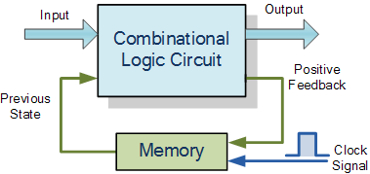
SEQUENTIAL CIRCUITS
Introduction to Sequential Circuit
Difference between Latch & Flip Flop
Types of Flip Flops
SR Flip Flop in details
Figure 2: Sequential circuit

Slide 6
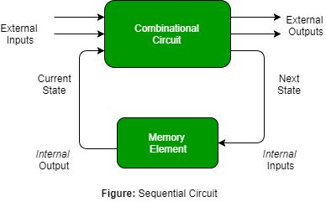
INTRODUCTION TO SEQUENTIAL CIRCUIT
Sequential circuit provides an output based on current input and past input variables [3].
Sequential circuits consists of memory elements to store binary information.
Figure 3 Basic of the Sequential circuit

Slide 7
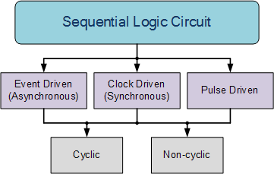
CLASSIFICATION OF SEQUENTIAL CIRCUITS
Event Driven
Clock Driven
Pulse Driven
Figure 3 Classification of Sequential circuit

Slide 8
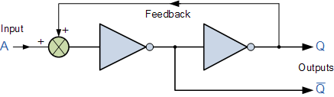
SEQUENTIAL FEEDBACK LOOP
To retain their current state, sequential circuits rely on feedback.
In feedback a fraction of the output is fed back to the input.
Figure 4 Feedback in Sequential circuit

Slide 9
LATCH
Latches are basic storage elements which operate with signal levels.
Latches controlled by a clock transition are known as flip-flops.
These are level-sensitive devices.
Latches are used for the design of the asynchronous sequential circuit.
Flip Flop are made from Latches.

Slide 10
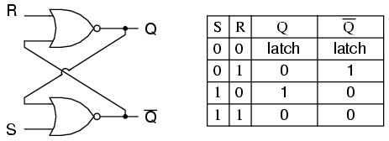
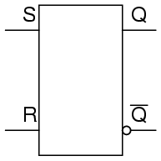
WORKING OF LATCH
SR Latch
Figure 5: SR Latch

Slide 11
DIFFERENCE BETWEEN LATCH AND FLIP FLOP
Latch | Flip Flop
It does not require clock signal. | It requires clock signal.
It is level sensitive device. | It is edge sensitive.
Power requirement is less. | Power requirement is more.
Fast operation. | Slow operation.

Slide 12
FLIP FLOP
Flip-flop is a basic digital memory circuit, which stores one bit of information.
Flip flops are the fundamental blocks of most sequential circuits.
It is also known as a bistable multivibrator or a binary or one-bit memory.
Flip-flops are used as memory elements in sequential circuit.
Clocked flip flops serve as memory elements in synchronous sequential circuits.
Unclocked flip-flops (i.e., latches) serve as memory elements in asynchronous sequential circuits.

Slide 13
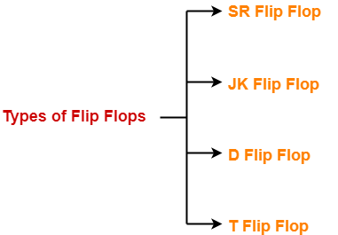
TYPES OF FLIP FLOPS
Figure 6: Types of Flip Flops

Slide 14
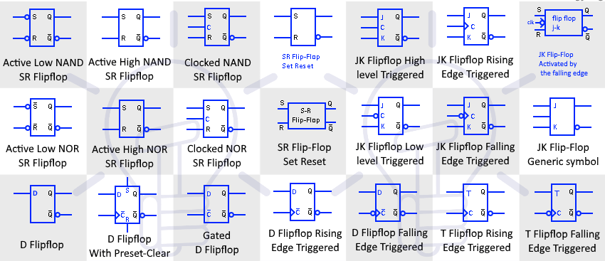
Symbols of Flip Flops
Figure 7 Symbols of Flip Flops

Slide 15
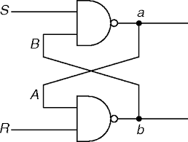
1-bit Memory Cell Using NAND Gate
S | R | Q | Q’
0 | 0 | Race | Race
0 | 1 | 0 | 1 | Reset
1 | 0 | 1 | 0 | Set
1 | 1 | Same as previous | Same as previous

Slide 16
1-bit Memory Cell Using NOR Gate
S | R | Q | Q’
0 | 0 | Same as previous | Same as previous
0 | 1 | 0 | 1 | Reset
1 | 0 | 1 | 0 | Set
1 | 1 | Race | Race

Slide 17
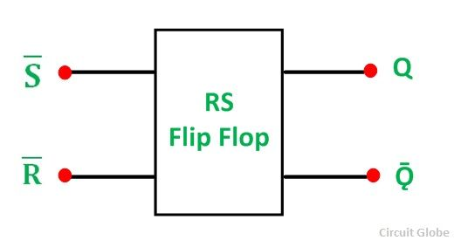
SR FLIP FLOP
It is also known as SR Latch.
It is a sequential circuit.
It is one-bit memory bistable device.
It has two outputs:
“SET” the device (output = “1”).
“RESET” the device (output = “0”).
Figure 8 SR Flip Flop Symbol Diagram

Slide 18
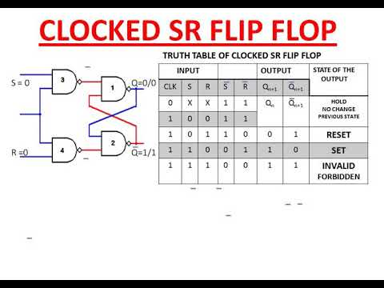

Slide 19
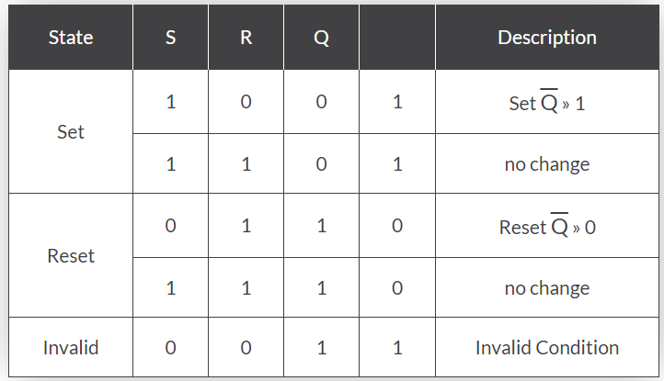
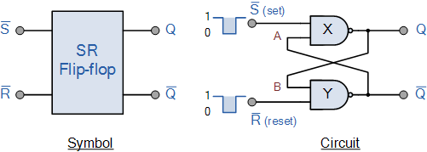
SR FLIP FLOP WORKING
Figure 9 SR Flip Flop Logic Diagram
Figure 10: SR Flip Flop Truth Table

Slide 20
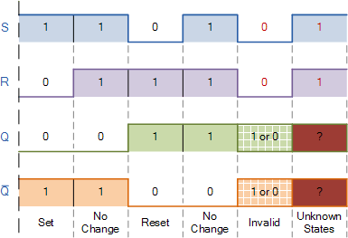
Cont…
Figure 11: SR Flip Flop Switching Diagram

Slide 21
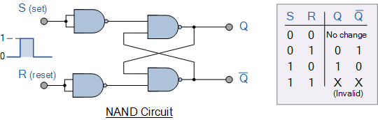
NAND GATE SR FLIP FLOP
Figure 12 NAND Gate SR Flip Flop

Slide 22
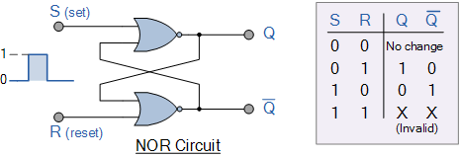
NOR GATE SR FLIP FLOP
Figure 13 NOR Gate SR Flip Flop

Slide 23
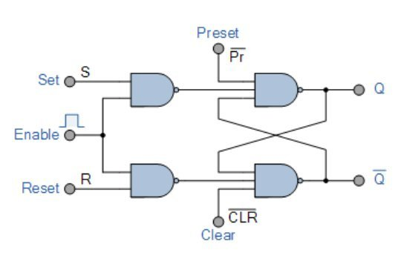
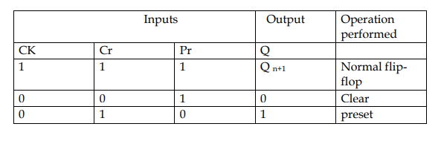

Slide 24
ADVANTAGES AND DISADVANTAGES
Advantages
Useful in building synchronously clocked logic.
Disadvantages
The SR Flip flop is not edge triggerable. Most Flip Flop circuits require edge triggering.
There is a more complex Flip Flop designed.
by Jack King that is very
The limits of the SR Flip Flop are overcome by cascading a second stage in the circuit which is arranged with a clock /clock line to cause an edge triggering option. The most basic version is called a D Flip Flop wherein D stands for Data.

Slide 25
APPLICATIONS
Registers
RAM (Random Access Memory)
Counters
Frequency Divider circuits
Data transfer
Static RAM
Microprocessor registers & latches
Shift registers
Counters
Switch debouncing
Oscillators
Signal conditioning and synchronization

Slide 26
ASSESSMENT PATTERN
Explain SR flip-flop.
Explain NAND gate S-R flip-flop.
For the clocked SR flip-flop writ the state table, draw the state diagram and the state equation.
For the clocked SR flip-flop writ the state table, draw the state diagram and the state equation.
Explain triggering of flip-flops with waveform.

Slide 27
REFERENCES
https://www.google.com/search?q=flip+flops+in+digital+electronics&source=lnms&tbm=isch&sa=X&ved=0ahUKEwjv46Hyu__iAhWMuY8KHVMCAxoQ_AUIESgC&biw=1366&bih=657#imgrc=Jr0JsbzuxbBXUM:
https://www.electronics-tutorials.ws/sequential/seq_1.html
https://www.geeksforgeeks.org/introduction-of-sequential-circuits/#:~:text=Combinational%20circuit%20produces%20an%20output,capable%20of%20storing%20binary%20information.
https://www.electronicshub.org/flip-flops/
https://www.allaboutcircuits.com/textbook/digital/chpt-10/s-r-latch/
https://www.electronicshub.org/jk-flipflop/
https://www.electrical4u.com/master-slave-flip-flop/
https://www.gatevidyalay.com/flip-flops-in-electronics/
https://www.electricaltechnology.org/2019/09/digital-flip-flop-and-latches-symbols.html
http://hades.mech.northwestern.edu/index.php/Flip-Flops_and_Latches
https://www.electronicshub.org/t-flip-flop/
https://www.electronics-tutorial.net/sequential-logic-circuits/toggle-flip-flop/
https://www.electronicshub.org/flip-flop-applications/
https://www.quora.com/What-is-the-function-of-flip-flops
Floyd & Jain, Digital Fundamentals, Pearson.
Mano,Morris, Digital Design, Prentice Hall of India.
Fletcher, An Engg. Approach to digital design, Prentice Hall of India.

Slide 28
THANK YOU

